Slide 1
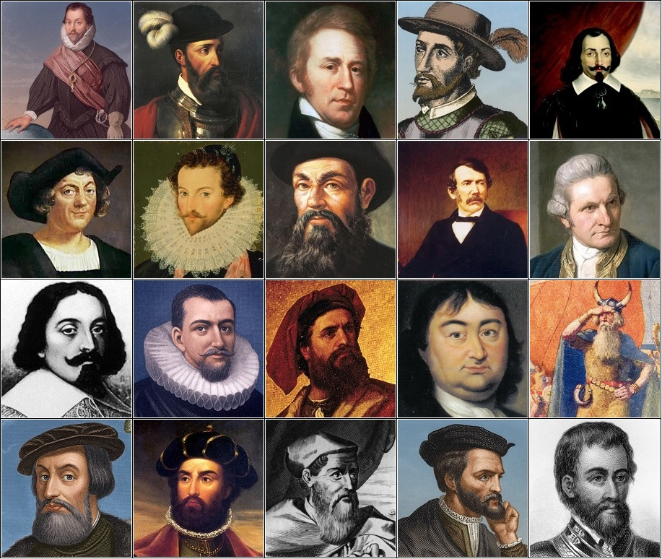
English
Instructions
We will be studying and writing instruction texts, detailing how to be a mighty explorer.
Recount
We will be writing a recount about a polar bear’s journey this half term.
Maths
We will be refocusing on number sense this half term, as well as beginning to learn about multiplicative reasoning.
PSHE/RSE
We will be learning about dreams and goals, focusing on aspiration, learning to achieve together and setting group challenges.
PE
Rugby
We will be developing our practical skills in rugby this half term, learning the appropriate techniques for throwing, catching, passing and running.
Dance
We will also be developing our physical movements and sporting techniques using simple movement patterns and sequences in Dance.
Explorers
Systems and Discovery
Systems aid discovery
Computing
We will be learning how to collect information using iPads (Y1+2) and Chromebooks (Y2) and communicate our learning within our Inquiry.
DT and Art
We will be learning how to master practical skills, by making ship-shaped biscuits, as well as drawing and painting in Art.
Inquiry
Our inquiry will be focused on systems and discovery by understanding these concepts, learning about discoveries and exploration, focusing on journeys made by explorers, and the systems used to aid these discoveries.
RE
RE will be focused on Christianity this half term, looking into what Christians believe God is like.
Music
We will be learning to compose and perform music, focusing on the song ‘I Go Africa’
Science
We will be investigating and describing the basic needs of animals including humans. We will also be learning about the importance of exercise, eating the right amount of different foods, as well as understanding hygiene.

