Slide 1
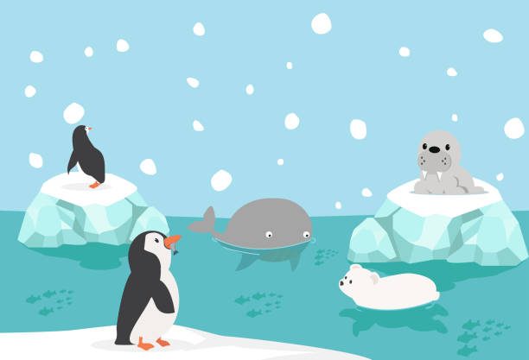
Communication and Language
We will explore the language associated with seasonal change and look at ice and changing states of matter (Linked to science)
We will continue to add new words and vocabulary to our word tree through discussion, stories and rhymes and through mathematical language. We will be ‘Terrific Talkers’ and speak clearly engaging in conversation about what we have done and are going to do.
Personal and social development
Our inquiry will be focused on ‘Living in the wider world’. Belonging to a community – our school, our village, Cornwall and important people in our community.
Physical development
We will refine fundamental movement skills, develop strength, balance, agility and co-ordination and develop fine motor skills, using a range of tools competently and safely, combining movements, developing skills focusing on dance and rugby.
Travelling
We will explore the different ways in which we can travel, using transport, on foot, using body movements.
We will find where we are going to by using a map.
Explorers: Poles apart!
Early Years
Expressive arts and design
We will be exploring at primary and secondary colours,mixing colours and making paintings using tones of blue and red. We will talk about the work of Kandinsky, Mondrian and Picasso’s blue and rose periods. We will paint self portraits using shades of one colour and we will make Ships biscuits as part of our Design Technology topic.
Literacy
We will continue to make our own books and begin to write labels and captions building up to a writing a sentence. We will discuss how to be a mighty explorer and write a postcard about polar bear’s journey.
We will continue with daily Phonics, recapping on set 1 sounds leading on to set 2.
We will practice letter formation and continue to read words using Fred Fingers.
Maths
We will be representing, comparing and composing the numbers 4 and 5 and 6, 7 and 8 and also introduce zero.
We will be making pairs, combining 2 groups of numbers.
We will explore the language of associated with mass and capacity and we will investigate the mathematical language associated with length and height.
Understanding of the world
We will be learning about people and animals living in different places around the world. Why are Polar regions cold, icy and have snow? Why are deserts dry and sandy and very hot in the day and very cold at night?
Is there more sea than land on earth?
We will look at why some places are special and why. We will learn about Chinese New Year.

