Slide 1
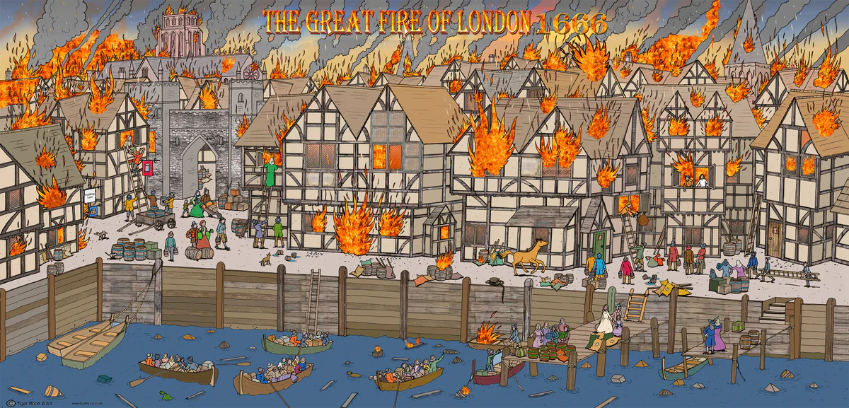
Computing
We will be continuing to understand how to communicate our learning using Seesaw, using iPads to present and explain our learning.
DT and Art
We will be learning how to master practical skills, by creating collages of The Great Fire of London, as well as making tie dye t-shirts with fire colours and effects.
Maths
We will be refocusing on geometric reasoning and number sense this half term.
PSHE/RSE
We will be learning about relationships this half term, focusing on families, friends, trust and safety.
PE
Basketball
We will be developing our skills in basketball this half term, learning the appropriate techniques for throwing, catching, passing, dribbling and shooting.
Tennis
We will also be developing our skills in tennis this half term, focusing on holding a racket, hitting underarm and from the side, and footwork to position ourselves correctly.
The Great Fire of London
Historical event and Documentation
Documentation recounts the past
English
Explanation
We will be studying and writing explanation texts, outlining how and why the fire spread.
Diary recount
We will be writing recounts in the form of a diary, taking inspiration from Samuel Pepys and writing diaries from when the fire was taking place.
RE
RE will be focused on Judaism this half term, looking into who is Jewish and how Jews live.
Music
We will be learning to transcribe and perform music, focusing on the song ‘London’s Burning’.
Science
We will be investigating living things this half term, focusing specifically on habitats and food chains. We will focus on these by investigating how we know something is alive, as well as exploring and creating food chains.
Inquiry
Our inquiry will be focused on documentation and historical event by understanding these concepts, learning about what happened, what caused the fire, why it was not put out, the infrastructure of London, Samuel Pepys, and what we learned from the event.

